Slide 1


By- Dr.Ajaz Qadir

Slide 2
 Myxedema coma is a state of decompensated hypothyroidism.
 A person may have lab values identical to a "normal" hypothyroid state, but a stressful event precipitates the myxedema coma state.

Slide 3
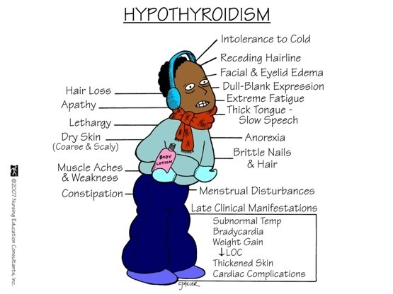

Slide 4
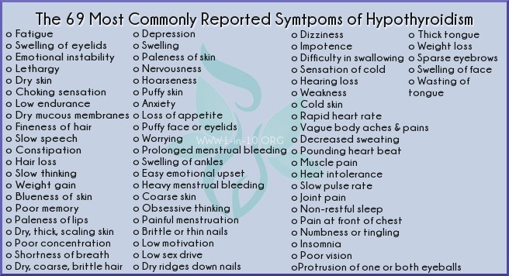

Slide 5
Primary symptoms of myxedema coma are

 altered mental status
low body temperature. Low blood sugar,
low blooodpressure, hyponatremia




 , hypercapnia,

hypoxia,
 slowed heart rate, and hypoventilation m

Slide 6

Myxedema coma was first reported by Ord in 1879 in London.
It is a rare disorder, with only approximately 300 cases described in the literature typically elderly females






have longstanding, undiagnosed hypothyroidism More than 90% of cases occur during winter months

Slide 7

 A 65-year-old woman with no known past medical history is brought to the emergency department with altered mental status. On arrival, the patient but arousable.
 Patient detailes

R.R =15 b/m
pH-7.23 paCO2-63.7
paO2-71.2 –R.A
 O2 = 92%
 Na = 128 mEq/L

Slide 8
 Examination
 generalized puffiness, periorbital edema, ptosis,
 macroglossia, and her extremities are dry and cool with nonpitting edema.
 INVESTIGATION

Slide 9
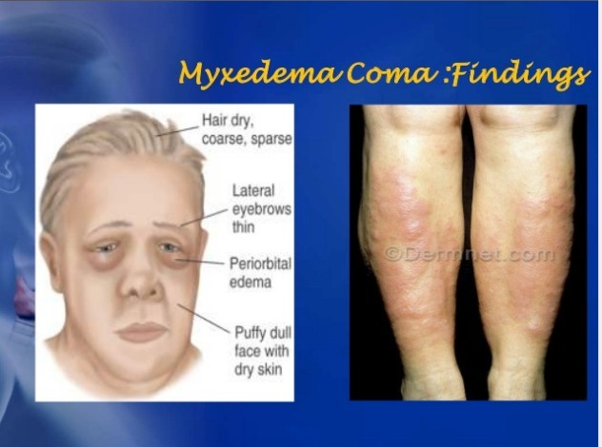

Slide 10

 The differential diagnosis of myxoedema coma will includes other causes of a deterioration in mental state:
 Hypothermia.
 Septic shock.
 Psychiatric disorders

Dementia (including Alzheimer's disease),Depression
 Changes in mental state secondary to other medical conditions and drugs,Hypoglycaemia (may co-exist)
 Encephalitis and meningitis, Hepatic encephalopathy, Cerebrovascular disease.

Slide 11
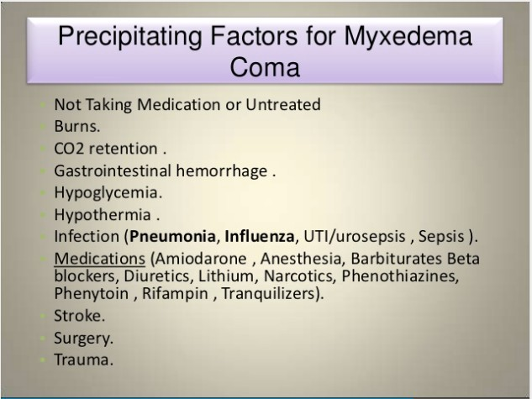

Slide 12
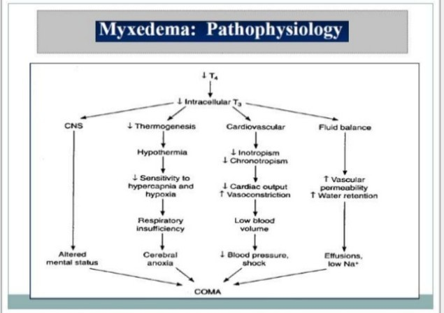

Slide 13
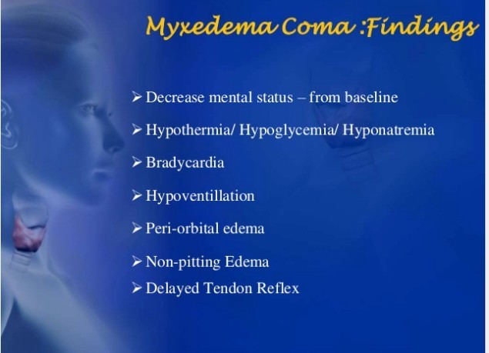

Slide 14
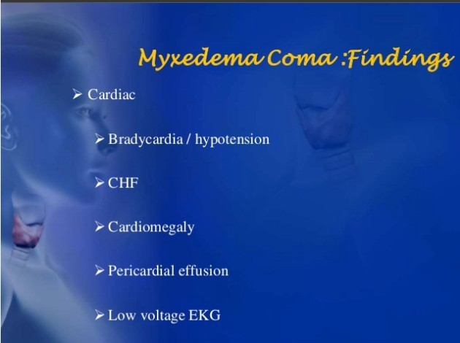

Slide 15
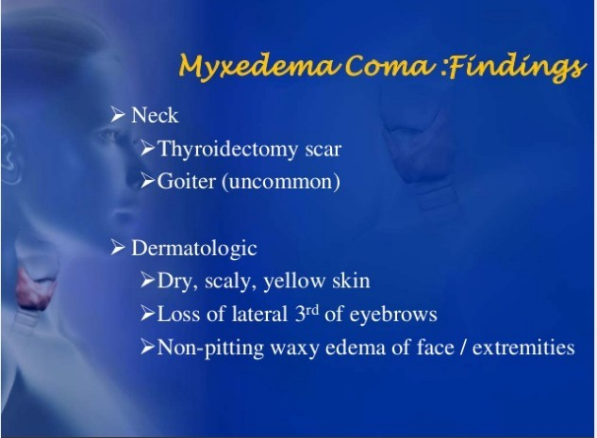

Slide 16
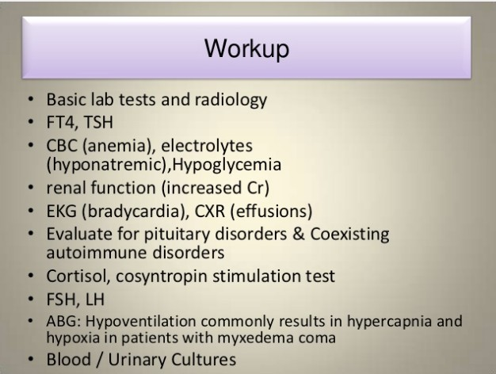

Slide 17
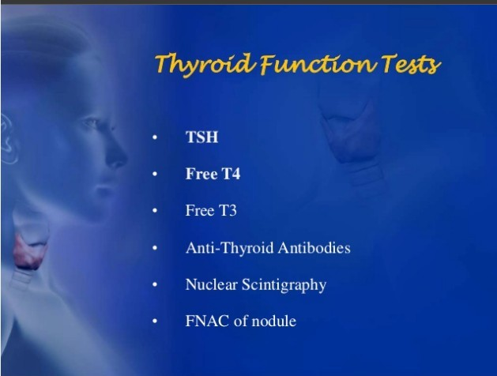

Slide 18

 Admit to intensive care unit for continuous monitoring of cardiovascular and pulmonary status
 Supportive care
 ABC measures
 Treat hypothermia with passive rewarming
 Treat hyponatremia with normal saline and free- water restriction

Slide 19
 Thyroid hormone treatment
 Levothyroxine (T4)
 Loading dose: 300 to 400 μg IV then 50 to 100 μg IV daily
 until oral medication can be given
 If suboptimal response consider concurrent liothyronine (T3): 5μg IV every 8 hr

Slide 20
 Corticosteroid therapy
 First draw baseline cortisol level and start hydrocortisone 100mg IV, followed by 50 mg IV every 6 to 8 hr
 Follow-up steroid therapy:

